Slide 1
M. Zeeshan Khalid
A small Journey of developed projects

Slide 2
01
WAF

Slide 3
WAF (Web Application Firewall)
Developed AI-based WAF for Malicious Attack Detection
Train on multiple parameters like XSS, SQL, JavaScript or other Attacks
This system can block malicious URL before its action
It can generate forensic reports on history.txt related files
It can detect crucial information about http, https , banking info and etc.
System uses Ensemble architecture for more accurate responses

Slide 4
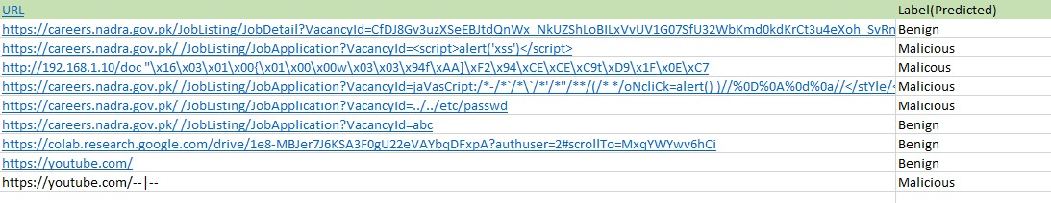
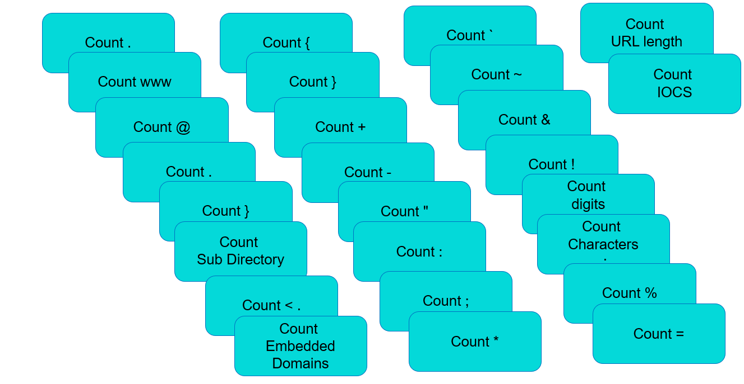
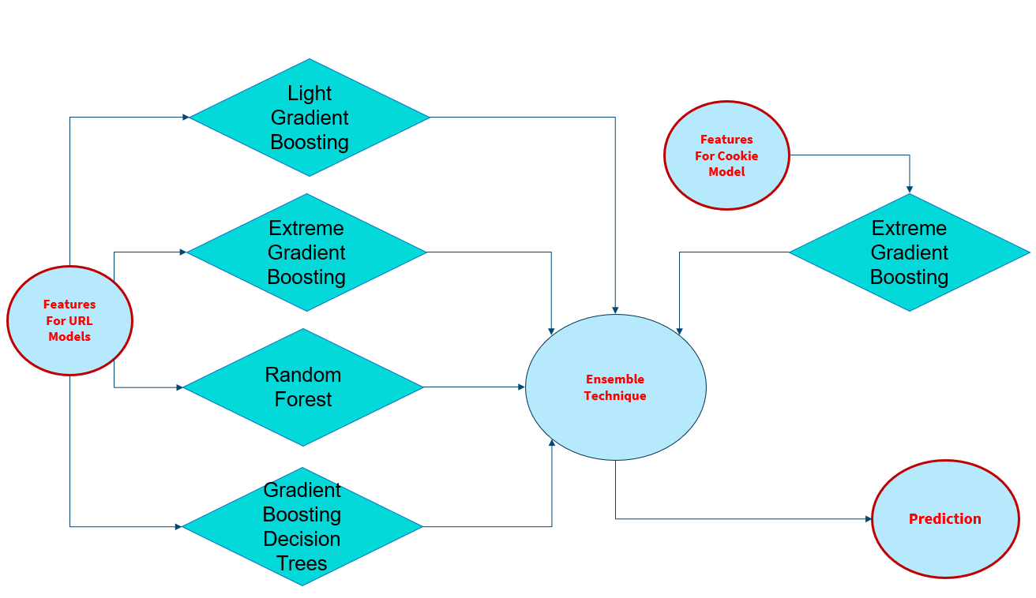

Slide 5
02
AGRO AI

Slide 6
AGRO AI (FYP)
Gathered a Dataset of weeds from local lands to target local problems
Trained the model for weed detection using Cloud Services
Developed a Car that can run on fields
Developed a REST API for conversation between feed and Server
System can get coordinates, when car runs on fields
Coordinates info, help the automatic weed killing tool to kill precisely

Slide 7
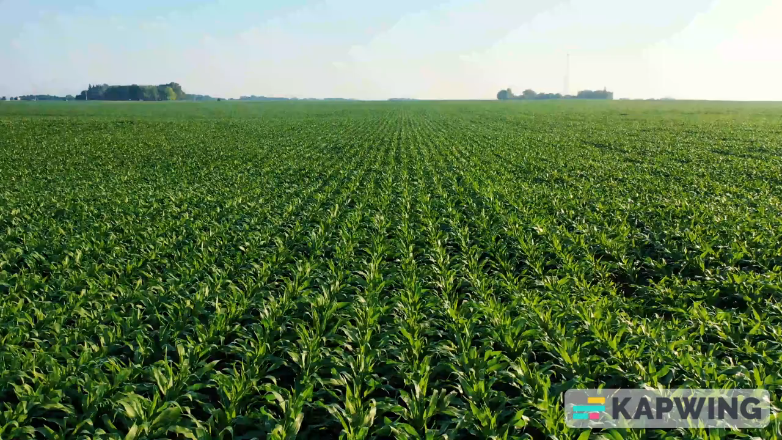

Slide 8
03
CCTV

Slide 9
Security Updates using CCTV Feeds
Developed a system that can create Dynamic Shapes on Realtime
User can set its own Restricted zone without hardcoding
User can set custom threshold for time analysis
On Crossing restricted threshold, System marks on specified entity
On Crossing restricted threshold, System saves the picture of that entity
System can use REST APIs for instant WhatsApp Notifications

Slide 10
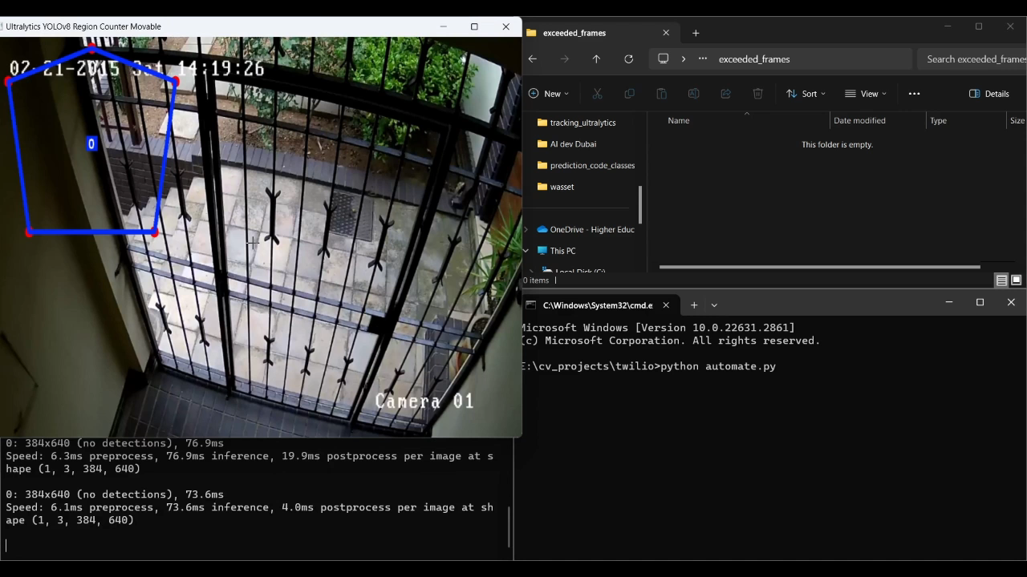
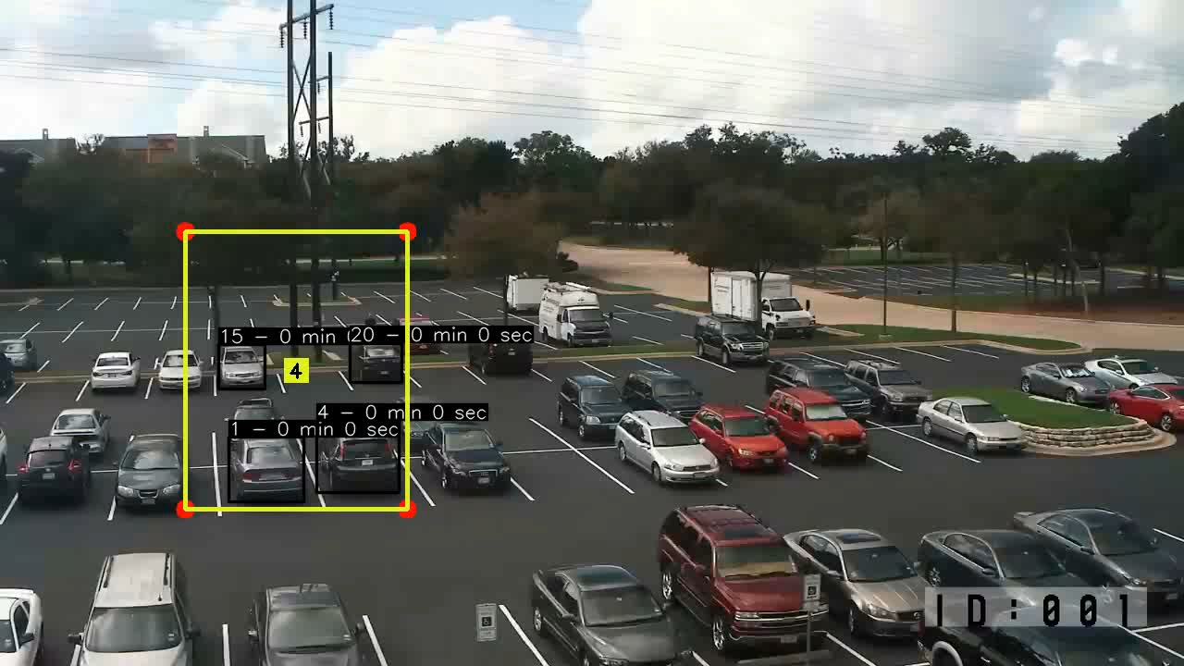

Slide 11
04
SIEM

Slide 12
SIEM Anomaly Detection using AI
SIEM (Security information and event management) is Cybersecurity tool, to detect and monitor about connected nodes
Added AI based Anomaly detection that detect anomalies on the Realtime basis using DBSCAN algorithm
Using REST APIs system send and retrieve record from Kibana and Elasticsearch using Python

Slide 13
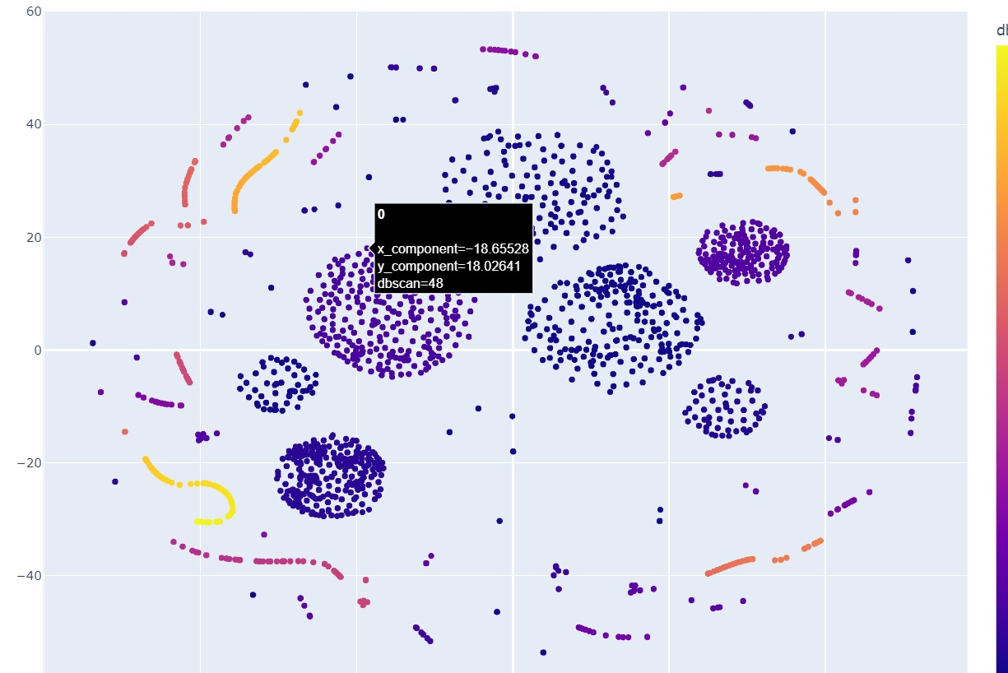
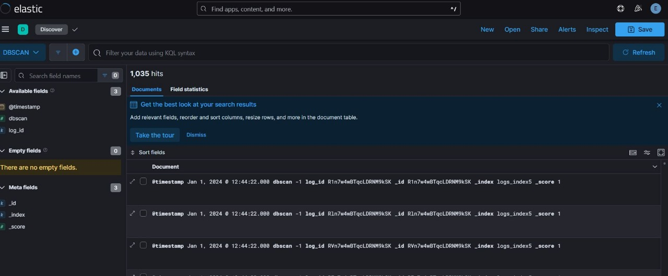
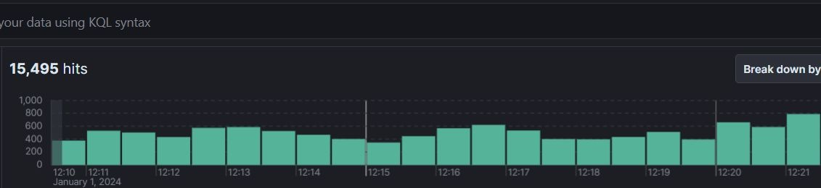

Slide 14
04
Cataract Disease

Slide 15
Cataract Eye Disease Detection
Main Aim is to distinguish between Cataract images
Uses ODIR Dataset from Kaggle
Augmented the Dataset
Train the model on Augmented Dataset
Developed a REST API for frontend
Created .exe for file transfer case

Slide 16
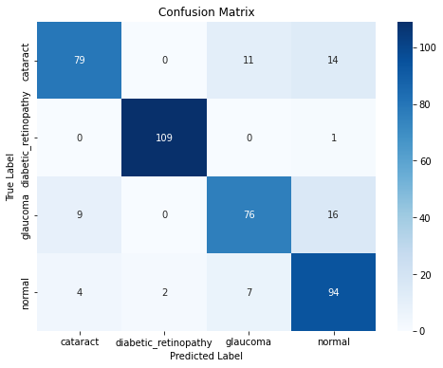
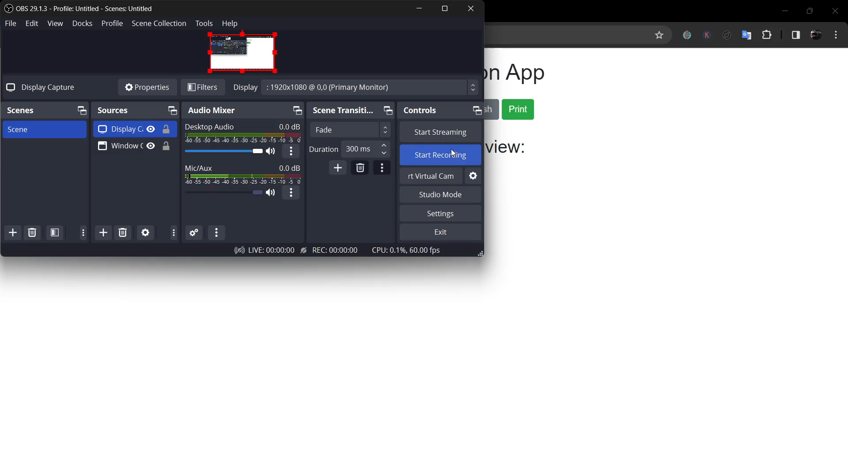
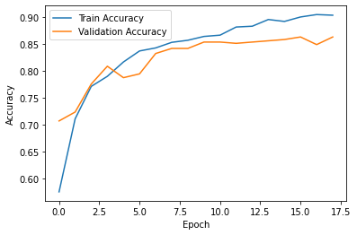
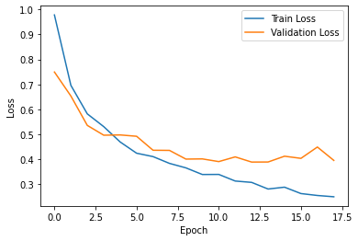

Slide 17
04
Car Signals

Slide 18
Car Signal Project (Cybersecurity)
Worked on Research Project for Car Signal Project
Use computer vison techniques to convert numeric data to images
Trained the model on Generated Images using Cloud Computing
Compared the old numeric data model vs image model

Slide 19
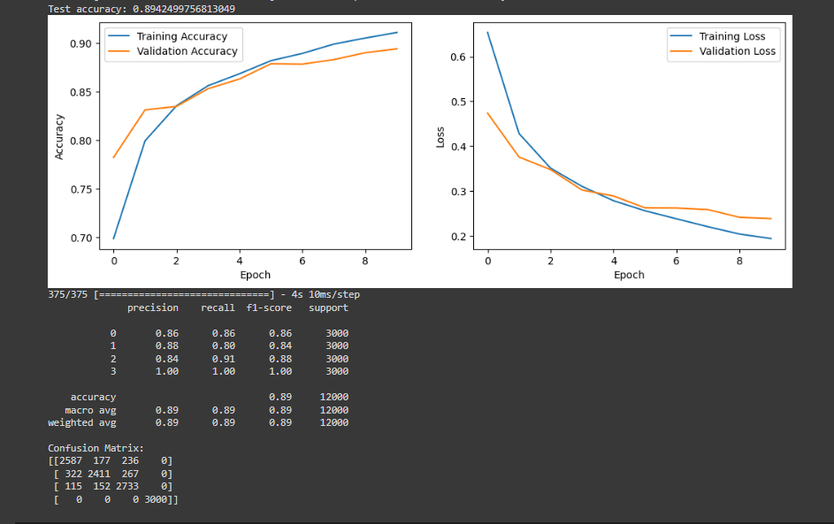
created Images

Slide 20
04
Brain Tumor

Slide 21
Brain Tumor Detection using Filters
Main Aim is to filter out Tumor region from an MRI image
Uses MRI images from Kaggle
Uses Computer Vision filters to filter out Tumor part
Use of Gaussian and Canny was effective in segmenting case
The project was implemented on MATLAB

Slide 22
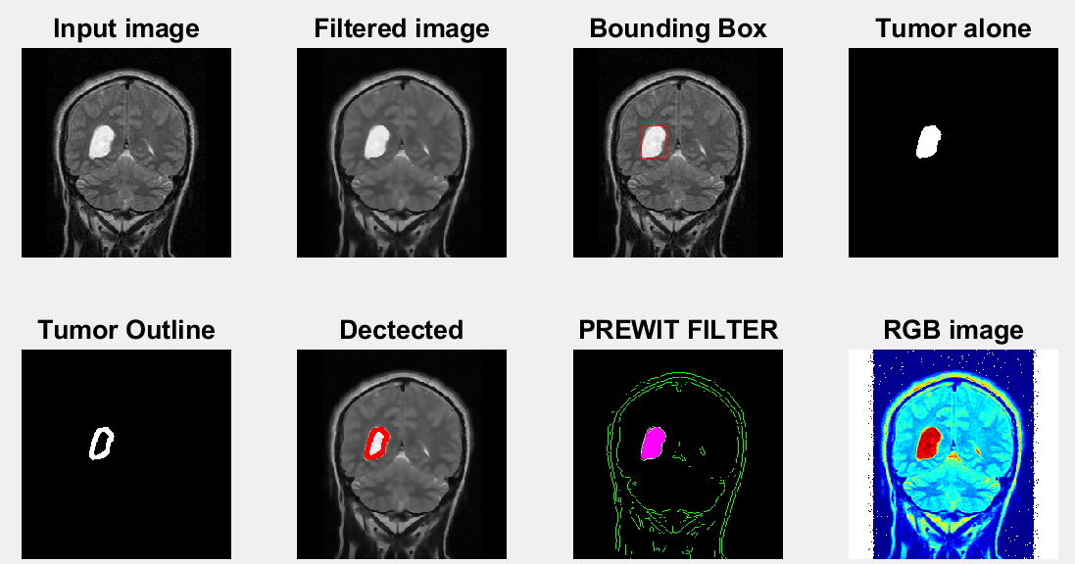

Slide 23
05
Highlight edges

Slide 24
Edge Detections using filters
Created Filters to create different looks in multiple aspects of same image
Created computer vision techniques to create filters
As a use case, it can be used in Apps or Webapps
Filters were implemented using Python

Slide 25
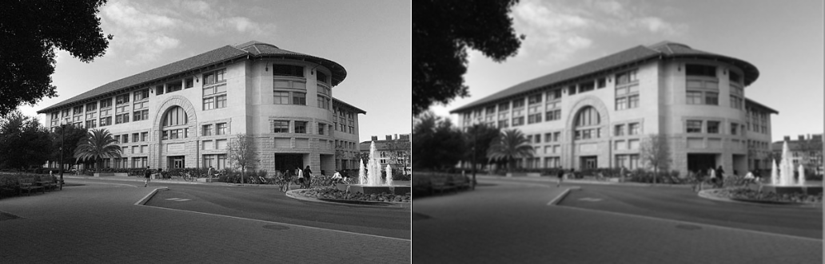
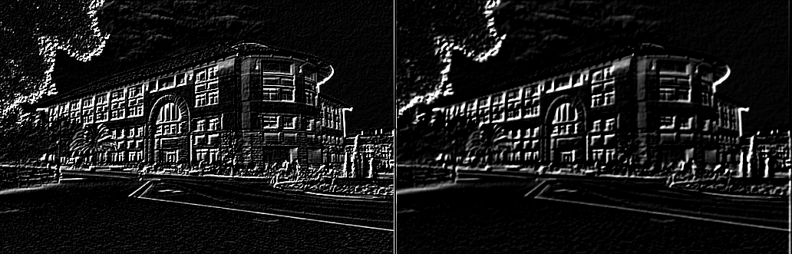
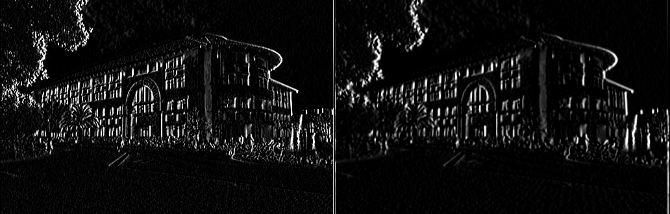
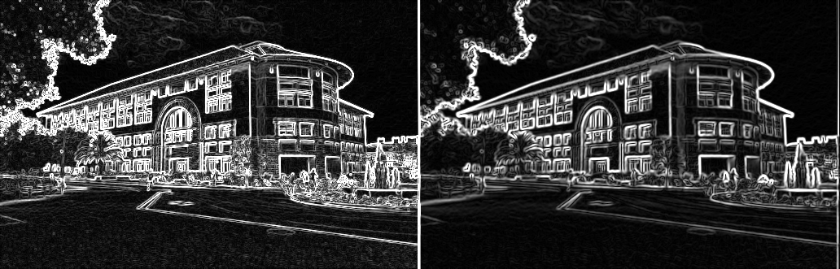
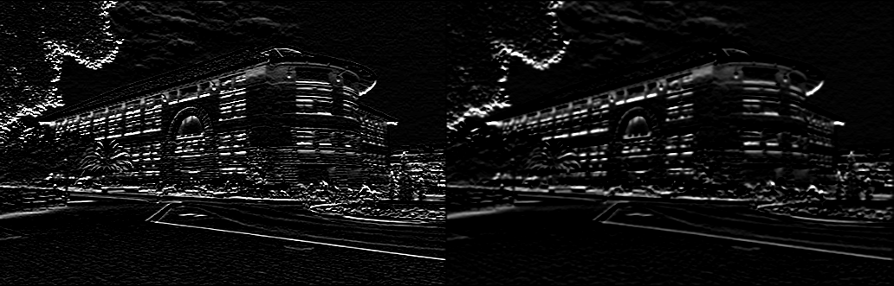
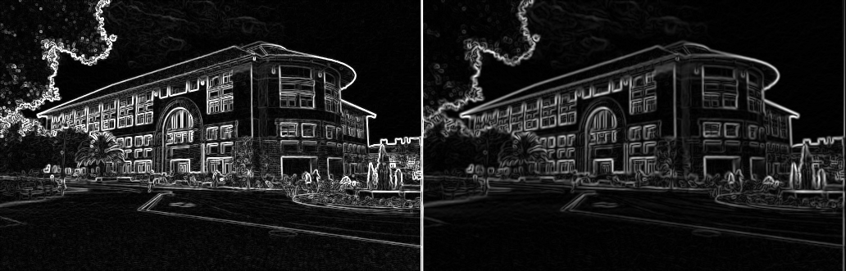
ORIGNAL GAUSSIAN
ORIGNAL GRADIENT
ORIGNAL GRADIENT (Thinner Edges)

Slide 26
06
PDF Chat

Slide 27
Chat with Documents
Use Generative-AI, to develop an App for ask queries from document
Use AWS for deployment of the project
Restricted the project, to input only one file at one file at a time
Developed a proper way, so that other user’s record not be shown
After 30 minutes, session will be deleted for all users
If user want to exceed files or time, then paid subscription can be given

Slide 28
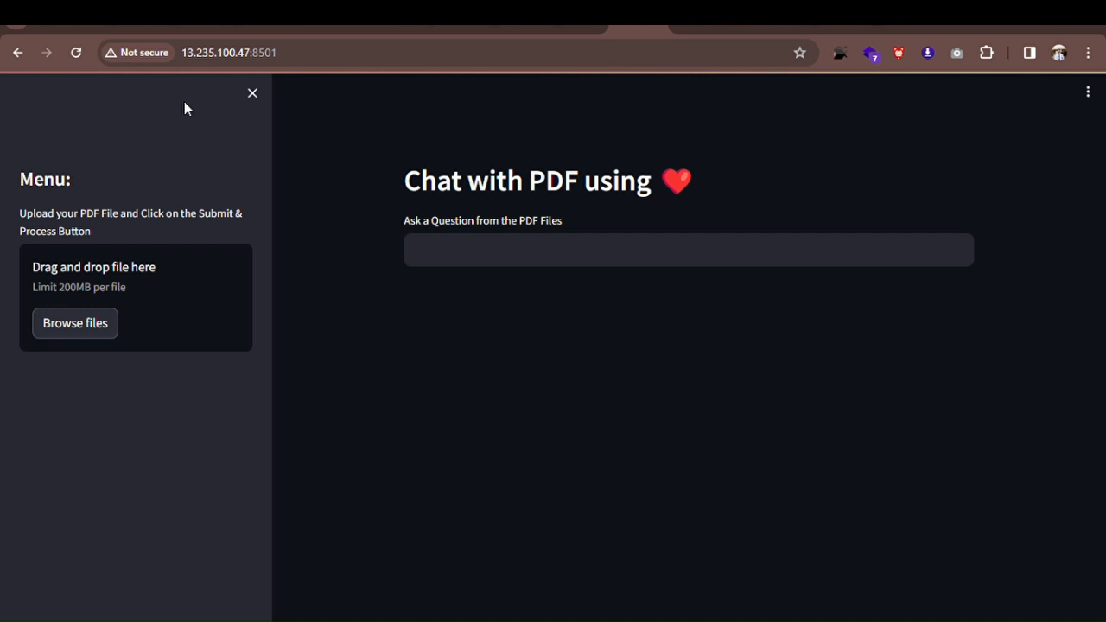

Slide 29
07
Generate Summary

Slide 30
YouTube Summary Generator
Use Generative AI to develop Summary Generator
Without opening video, Generate Summary of YouTube video
Helps by quickly seeing the conclusion of whole video
Developed REST API for the project
Integrated the system on the AWS as backend

Slide 31
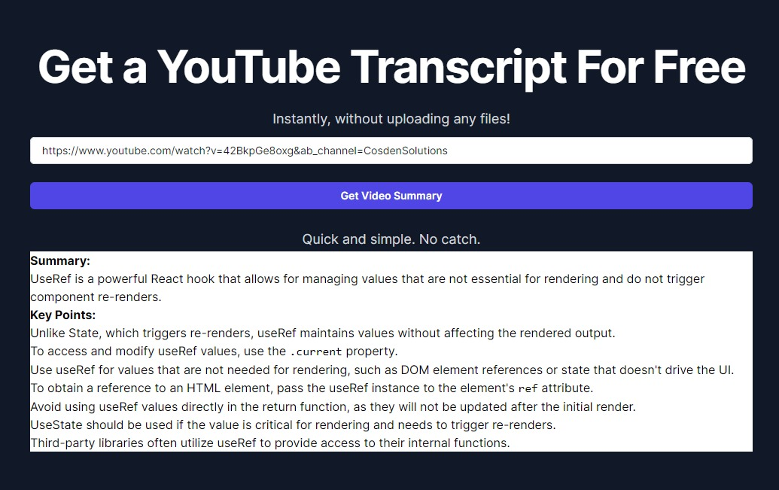

Slide 32
08
Researching ...

Slide 33
AI based Malicious PE Files Detection
Use scraping tools to generate the dataset
After getting dataset, use Sandbox to generate reports
Apply transfer learnings on generated reports
Apply Ensemble Learning techniques for high results
Showcase the results
This system can be applicable on both Linux and Windows OS

Slide 34












Scraping
Backlist
Scraping
Malicious
Feature Engineering
Benign
Model
Feature Engineering
Sandbox

Slide 35
09
Researching ...

Slide 36
AI based Forgery Detection using HIS (Forensics)
Imagine Attempting Forgery on Check filing or legal documents
This has a solution using HSI images
Because it has near to 140+ bands
We can distinguish between 2 different attempts
Because multiple dependent things are available like pressure points, ink difference, style difference etc.

Slide 37
10
Researching ...

Slide 38
AI based OS Device Drivers Identification
Imagine we got some computer which has unknown ports to us
We use our software kit based on hardware
System Generates the Appropriate Drivers Clusters using AI
System can be helpful in finding Driver details for multiple ports

Slide 39
